Slide 1
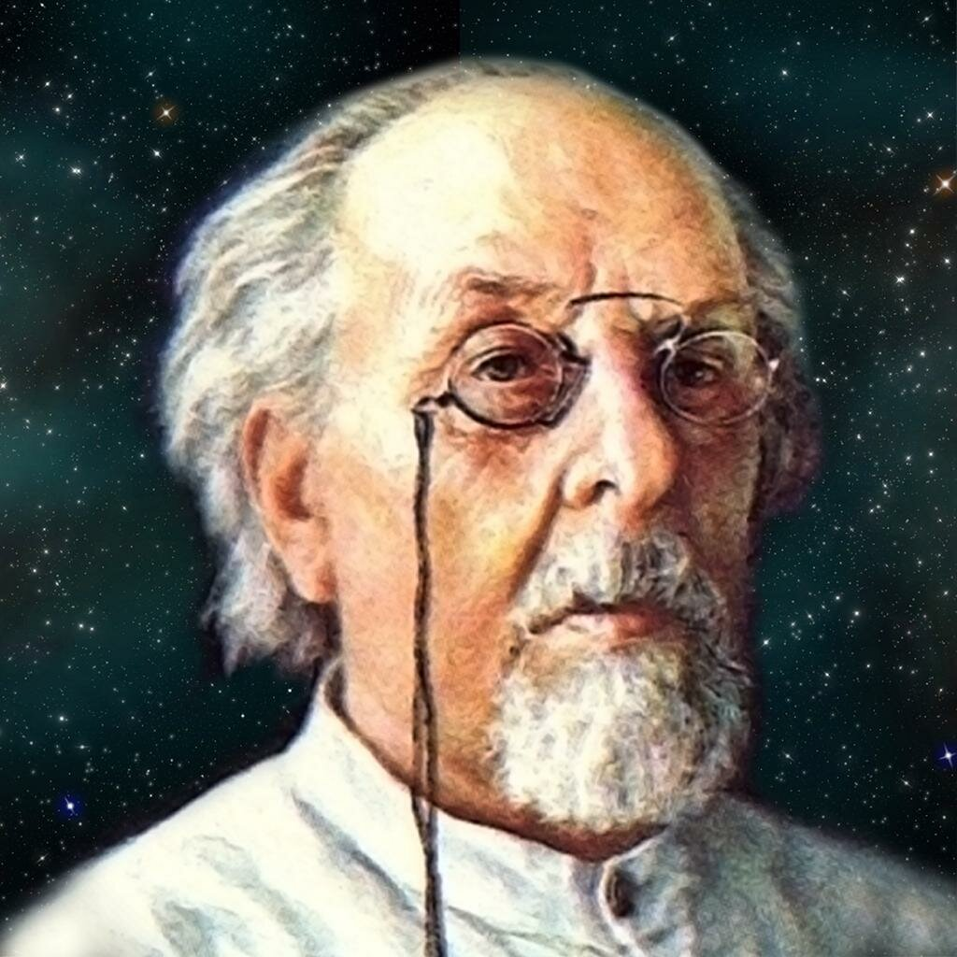
Konstantin Tsiolkovsky His life and works
Daniil Suturin, Dolgoprudny,
November 16, 2021

Slide 2
Contents
Biography of Konstantin Tsiolkovsky
Scientific activity
Memory of Konstantin Tsiolkovsky

Slide 3
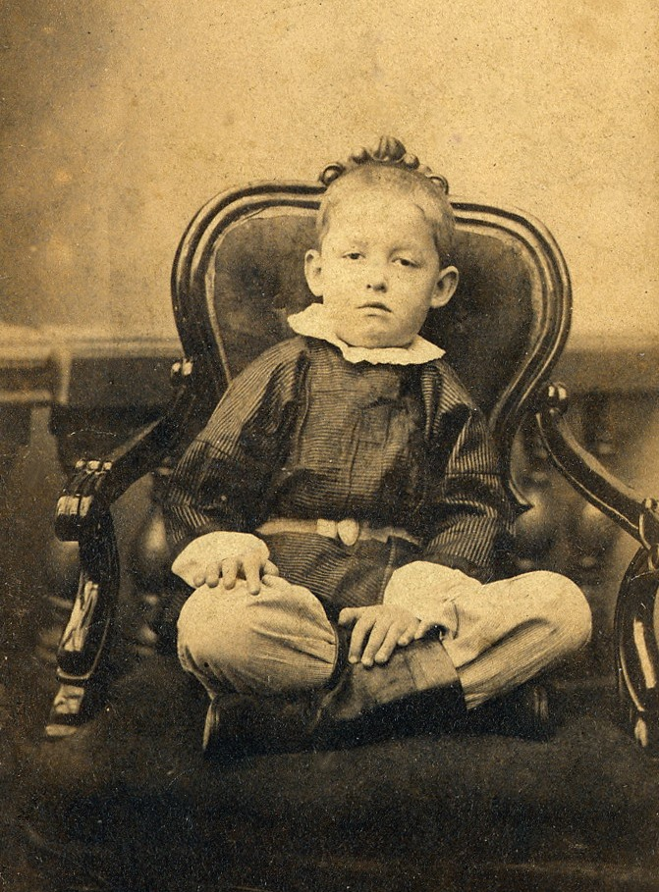
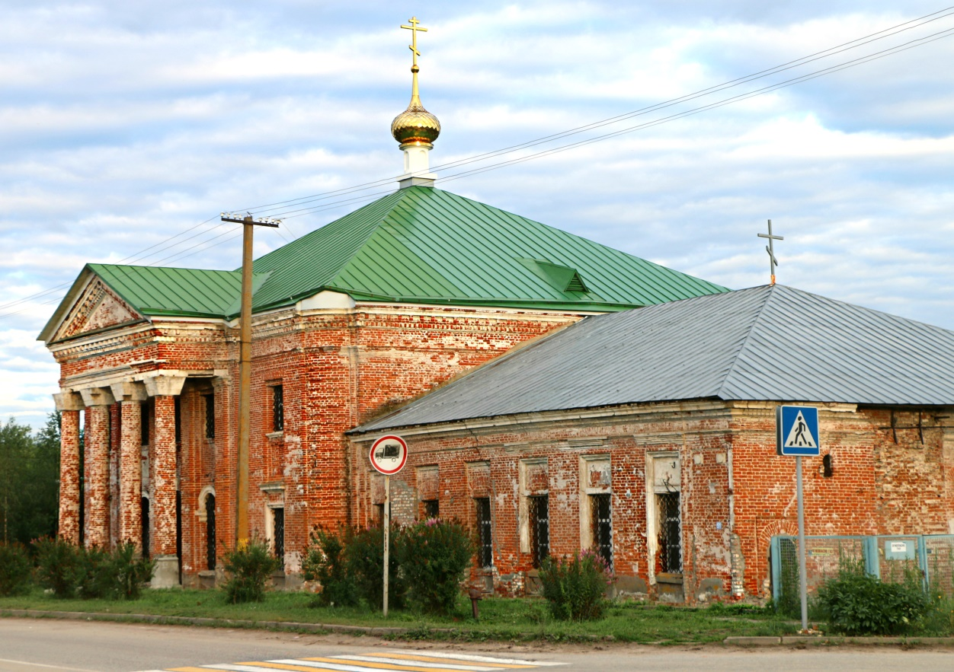
Early life
Modern Izhevskoe
Konstantin Tsiolkovsky, 6-7 years old

Slide 4
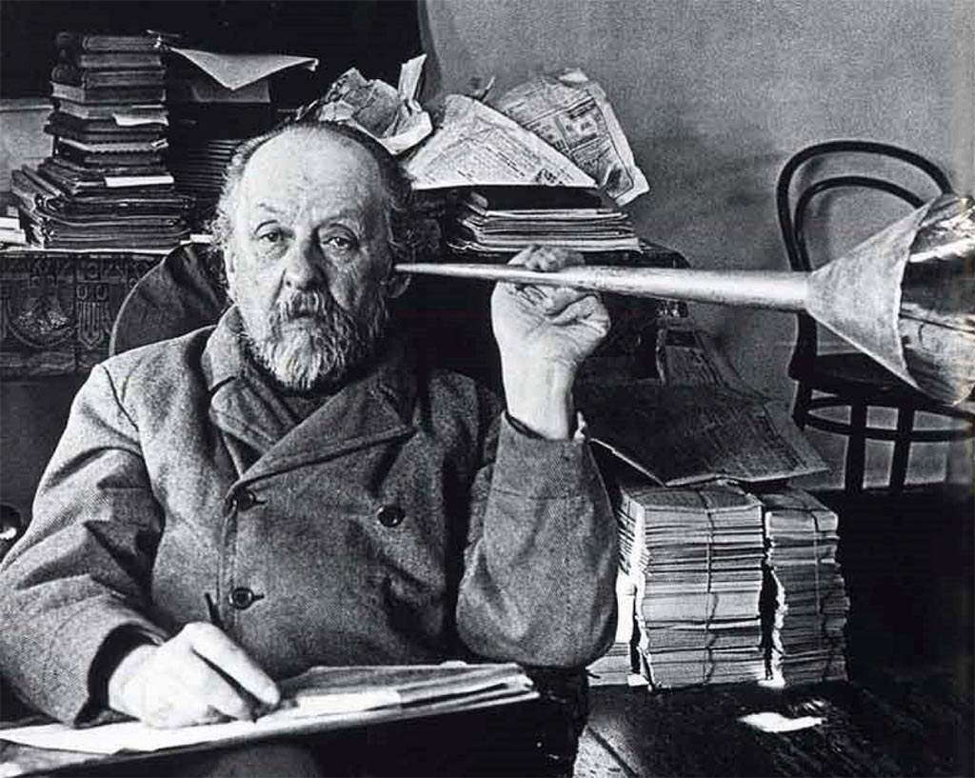
Early life
Tsiolkovsky with resonator in his cabinet

Slide 5
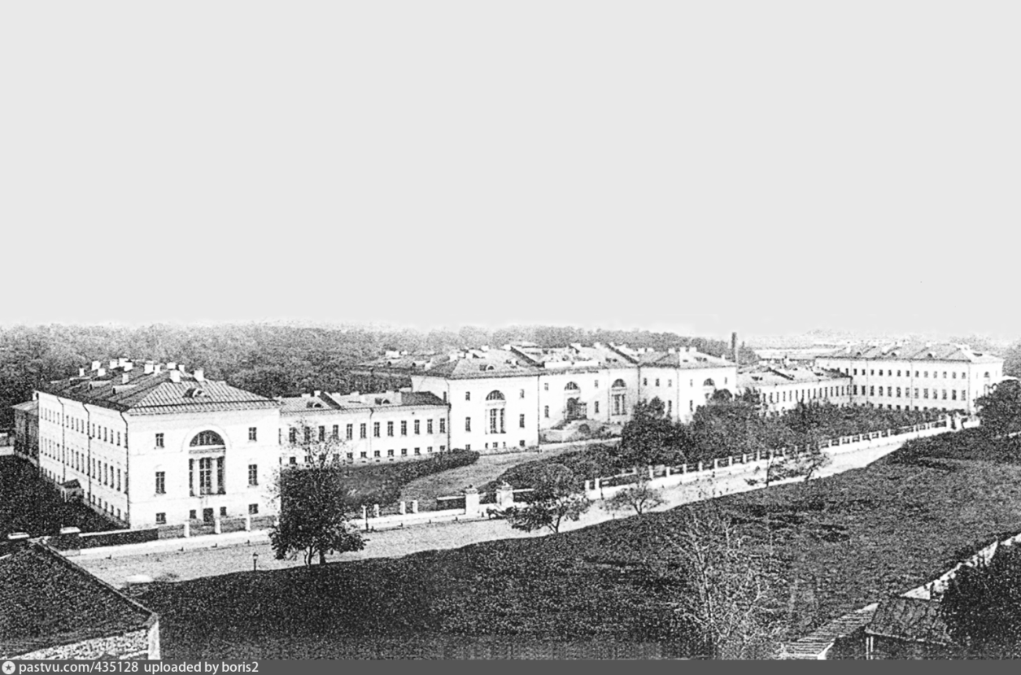
Early life
Moscow technical school

Slide 6
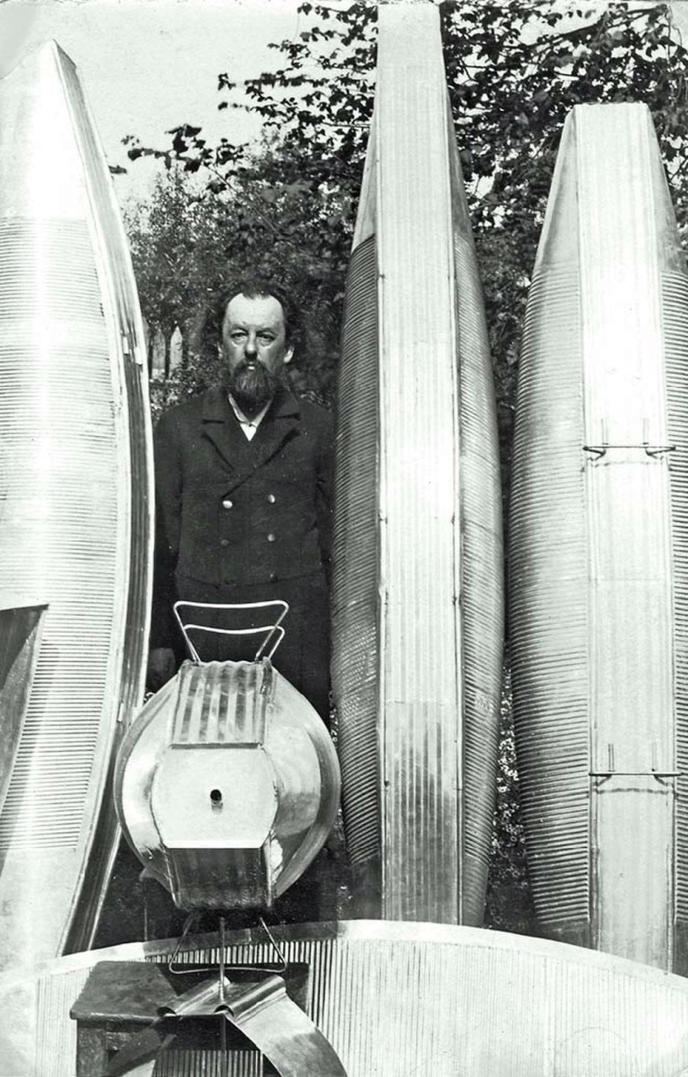
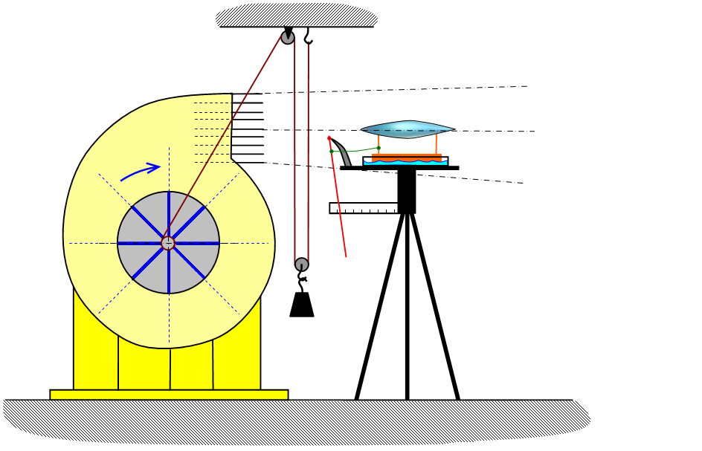
Scientific achievements
Tsiolkovsky wind tunnel
Konstantin Tsiolkovsky with his steel dirigibles in his garden

Slide 7
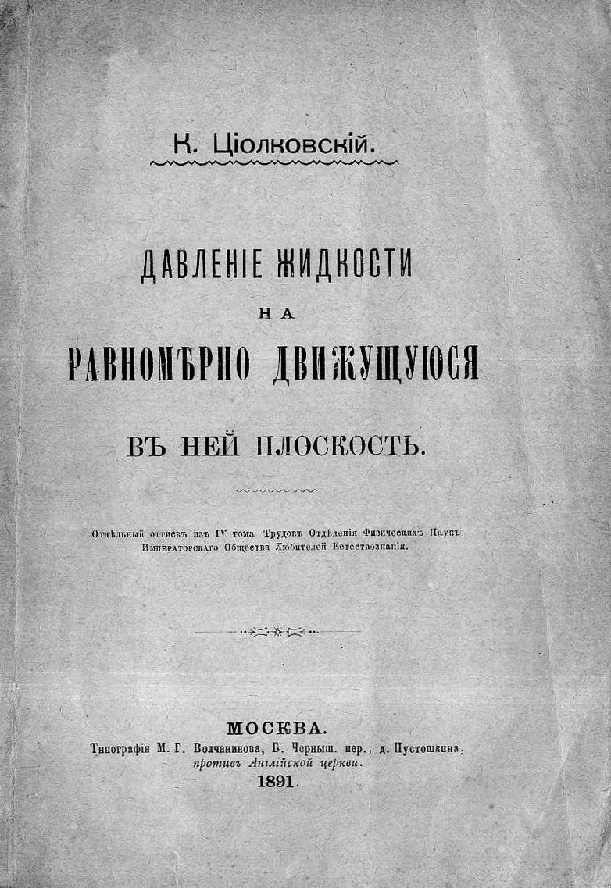
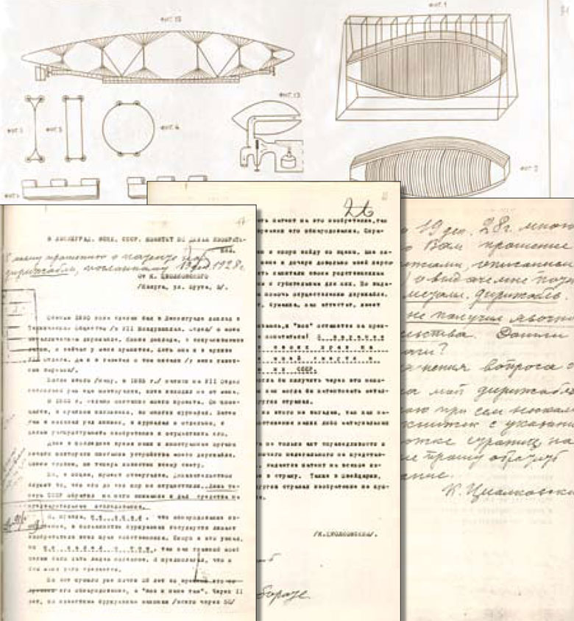
Scientific achievements
The first printed work of Tsiolkovsky "The pressure of a liquid on a plane evenly moving in it"
Tsiolkovsky dirigible patent

Slide 8

Scientific achievements
$V=U\ln{\frac{M_{0}}{M}}$

Slide 9
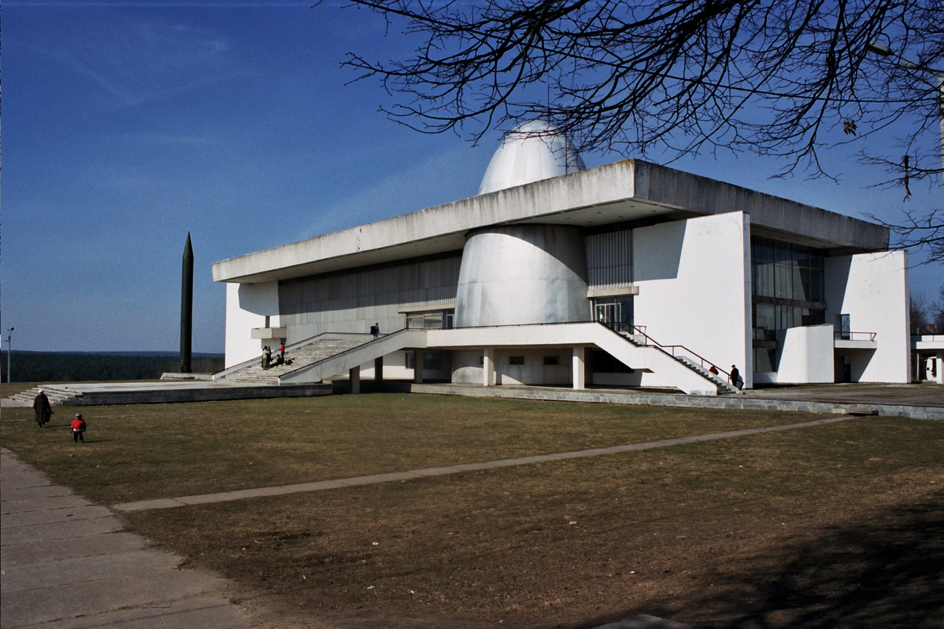
Memory of Konstantin Tsiolkovsky
Space museum in Kaluga

Slide 10
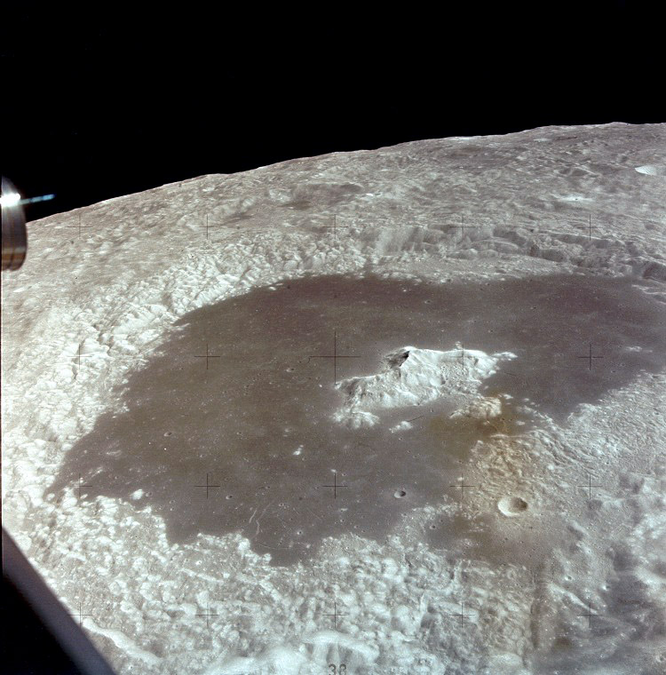
Memory of Konstantin Tsiolkovsky
Apollo 15 Tsiolkovsky Crater

Slide 11

Memory of Konstantin Tsiolkovsky
Flag of the city of Kaluga

Slide 12
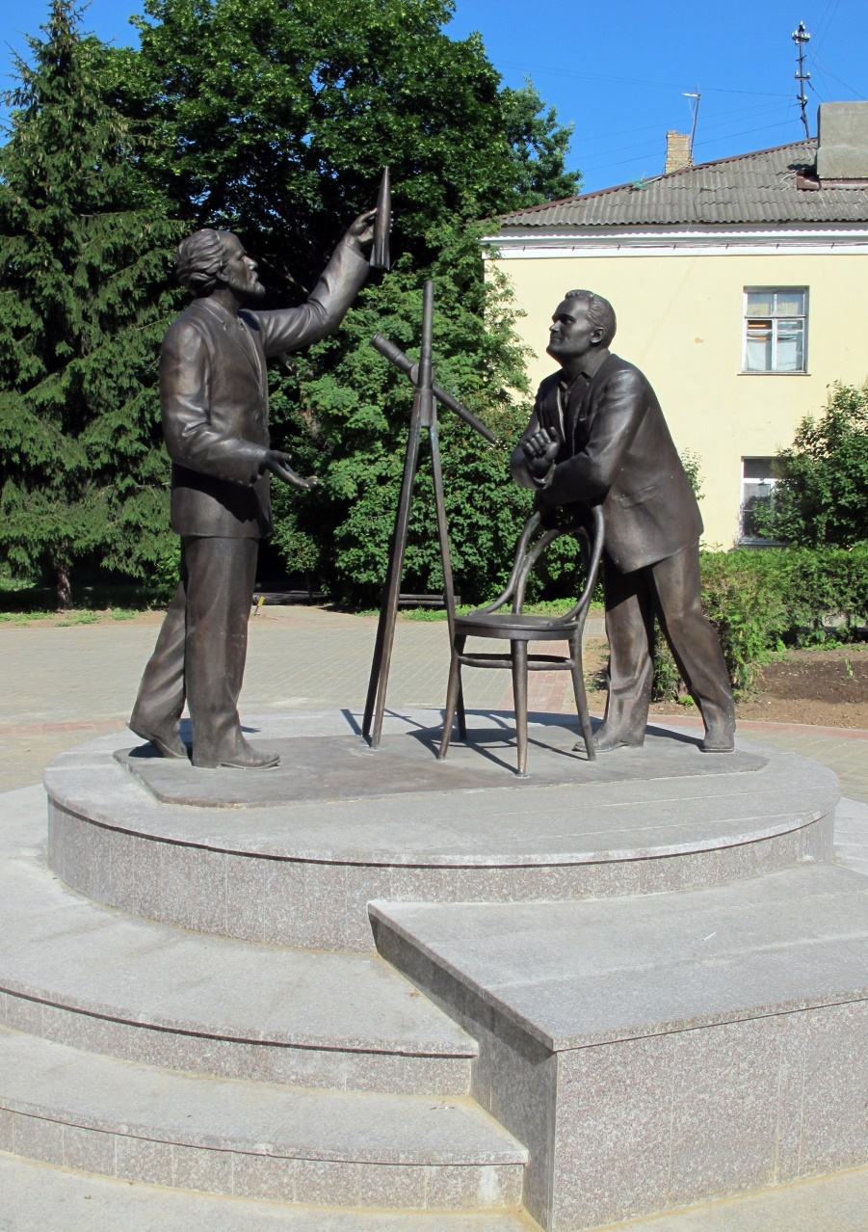
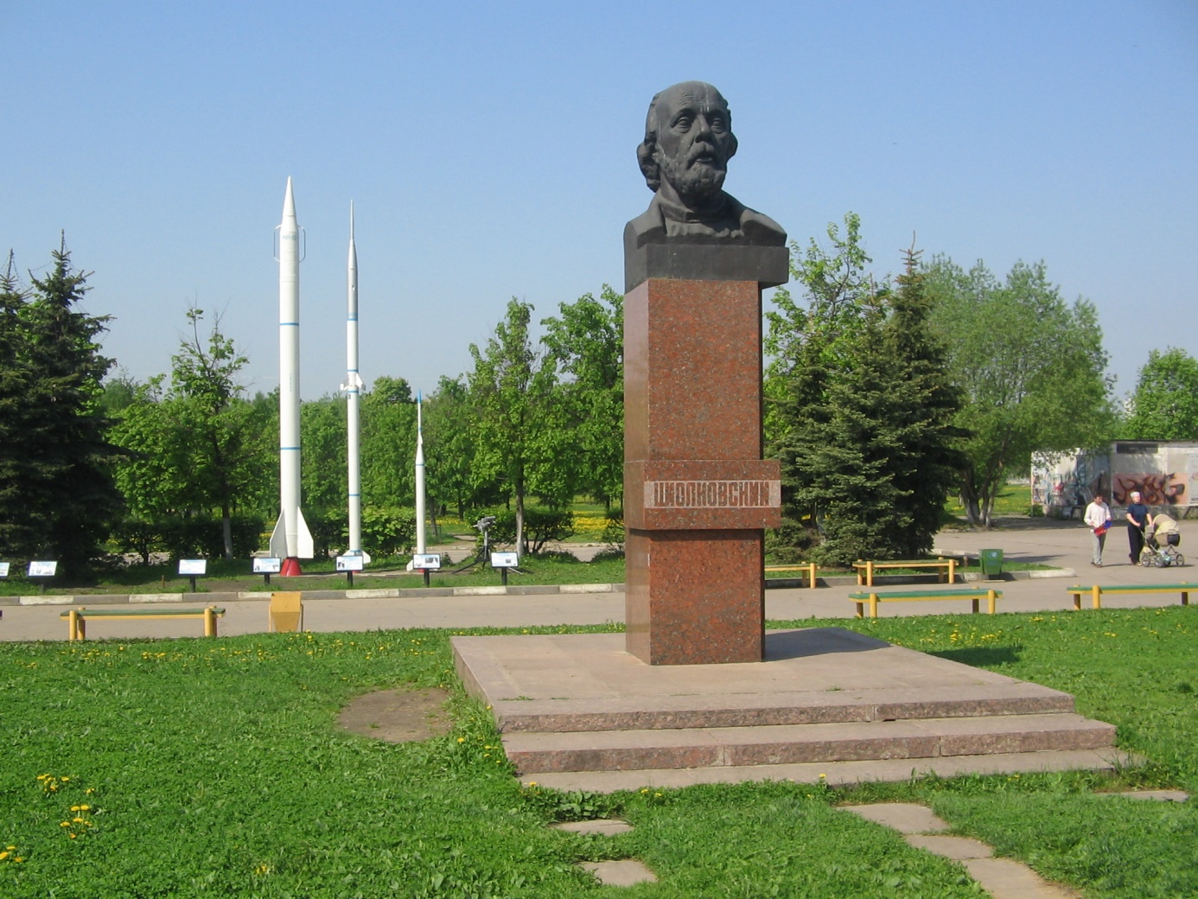
Memory of Konstantin Tsiolkovsky
Monument to Tsiolkovsky in Dolgoprudny
Monument to Tsiolkovsky and Korolev in Kaluga

